Slide 1

Query tuning, index utilization

Slide 2

Daily stand up
Name – Company
Something about Mongo admin/coding you know that no one else here knows
Something about Mongo you wish you knew
Your next major Mongo project
Start at
the end

Slide 3
Something I know
I know this is really easy.
I know most (many ?) people don’t know this.
I know having this memorized will make you really popular.
I know pressure sucks, and unnecessary.
I know my Kung Fu is not better than your Kung Fu.

Slide 4
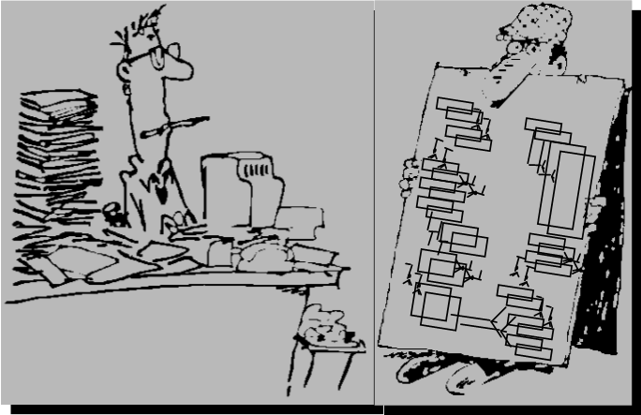
I inherited a MongoDB database server with 60 collections and 100 or so indexes.
The business users are complaining about slow report completion times.
What can I do to improve performance ?

Slide 5

Rules of Engagement
System tuning-
Memory
Process
Disk
Network
Application tuning-
Application architecture
Statement design
Data model design
Indexing, Query optimization
(Relational, so that we may compare/contrast)
Notes:
The validate command checks the structures within a namespace for correctness by scanning the collection’s data and indexes.
The command returns information regarding the on-disk representation of the collection.

Slide 6
And first’ish:
Y/N I have more than 24 months experience with SQL
Y/N I have more than 6 months
experience with MongoDB
Y/N I have written every query in MongoDB I ever needed, and was happy
Y/N Puppies scare me

Slide 7
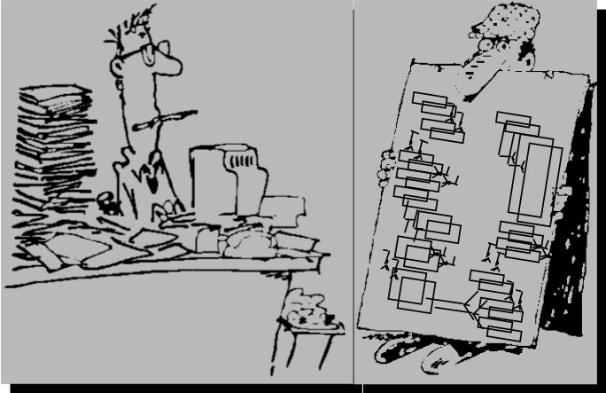
Detail command processing stages
Can apply the 5 rules to a Rule Based query optimizer
Apply 3 Index Negation guidelines
Repair common query design problems-
Pseudo order by clause
OR topped queries
(And topped queries, non-compound)
Drop and analyze query plans
Articulate/control FJS, & ESR query processing patterns
What you will
leave with in 60 minutes:

Slide 8
Queries 1 & 2:
SELECT * FROM phonebook
WHERE lastName LIKE “?son”;
SELECT * FROM phonebook
WHERE firstName = “Jennifer”;
Notes:
Note: Specifically the condition being discussed above is; negation of an index, non-initial substring.
Consider that a standard phone book is indexed (sorted by), last name then first name. If you query to find “Hanson, Mary”, you will likely do an indexed retrieval on last name; a couple of cached logical I/Os, find Hanson, then Mary, then a physical I/O to retrieve the full width data record. This is much preferred over sequentially scanning the whole phone book, faster too.
But what if you forgot Mary’s last name ? You know its something “son”; Hanson, Johnson, Williamson. When you lose the leading portion of the indexed string (key value), you negate the use of that index.
A similar condition is; negation of an index, non-anchored compound key.
That is, when the index is composed of multiple key values, and you fail to reference the leading key column or columns. In this case, you never knew the last name, only the first name. If you try to find all persons with a first name of Mary in the phone book, you must sequentially scan the whole book.
Generally, the only exception to a negation of an index, is when that index may be used for a covered query, that is; a key only retrieval.

Slide 9
Query 3:
CREATE TABLE t1 (col1, col_2, .. 80 more columns);
CREATE INDEX i1 ON t1 (col_gender);
SELECT * FROM t1
WHERE col_gender = “F” AND col_age > 50;
Notes:
Selectivity of a filter/predicate
--
Other indexes ?
skip scan NEXT SLIDE

Slide 10
Negation of an index
Non-initial substring
Non-anchored compound/composite key
(Poor) selectivity of a filter
Partial negation of an index-
CREATE INDEX i1 ON t2 (col1, col2);
//
SELECT * FROM t1
WHERE col1 > 100 AND col2 = “x”;
Exception to all above-
Covered query/key-only
Notes:
If the index is on (col1, col2) likely to use leading portion of index (col1)
Then data page, and predicate col2 there.

Slide 11
(n) Stage database server back end
Notes:
Generally, database servers have a 4 or 5 stage back end, as depicted in . Your end user application program communicates, expectably over a network, to a single or set of dedicated database server processes that perform work on behalf of your application. But what steps does the database server execute when you request service ?
We display the 4 stage back end briefly so that we may introduce database server command processing-
With SQL at least and when using ODBC/JDBC, you can send literally any command to the database server. Step 1 then becomes parsing; did you send a SQL CREATE TABLE, a request for system backup or restore, a SQL SELECT, a SQL INSERT, what ?
If the statement you sent is a SELECT, UPDATE or DELETE, you then proceed to the query optimization and query processing stages. Each of these three statements must first read data, and have a plan to read (a query plan) that is as efficient as possible. All other statements (not SQL SELECT, SQL UPDATE, SQL DELETE) generally proceed to whatever set of run time libraries that exist below query processing.
MongoDB, by means of its native language client side libraries, incurs little or no load related to parsing. The client has already identified itself by executing the specific client side method to find(), insert(), other, and against a specifically identified namepsace; database and collection.
However the real point here is that query optimization exists as a distinct and automatic processing step in your request for database service.
Query optimization determines the collection access method; collection scan, or index scan, and which index. Query optimization also identifies the sequence in which query processing steps are executed; apply a predicate then sort, or sort then apply a predicate, etcetera. This determination is called the query plan.

Slide 12
Query Optimizers
?
Rule
Cost

Slide 13
5 Rules to a rule based optimizer
SELECT *
FROM orderHeader, orderLineItems
WHERE
oh.orderNumber =
oi.orderNumber;
SELECT *
FROM persons, OUTER automobiles
WHERE
p.personId = a.personId;
Outer table joins
(Non-outer) table joins
Filter criteria (predicates)
Table size
Table cardinality
Notes:
First 2 rules deal only with joins

Slide 14
Query 4: final/larger example using SQL

Slide 15
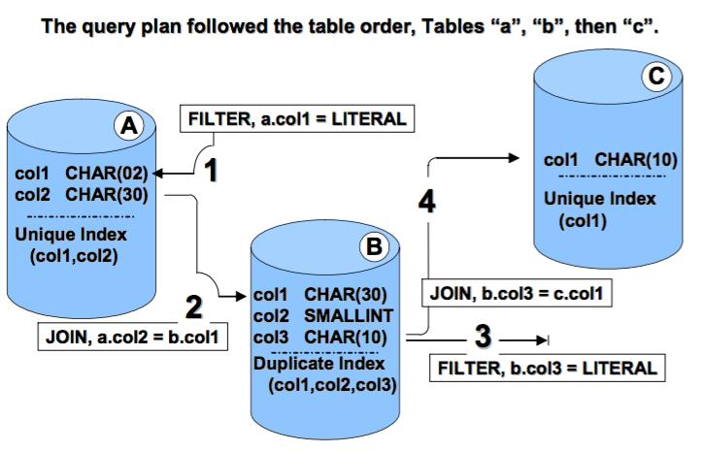
Example 4: query

Slide 16
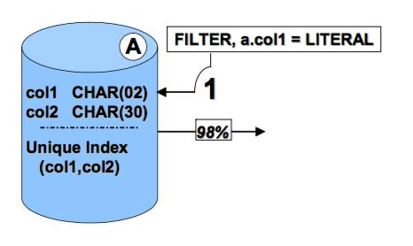
Query 4: First predicate

Slide 17
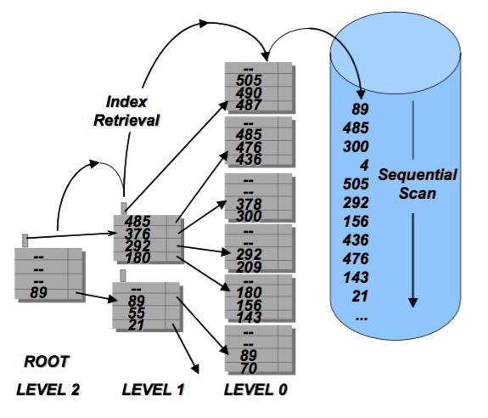
Collection access method: collection scan versus index scan

Slide 18
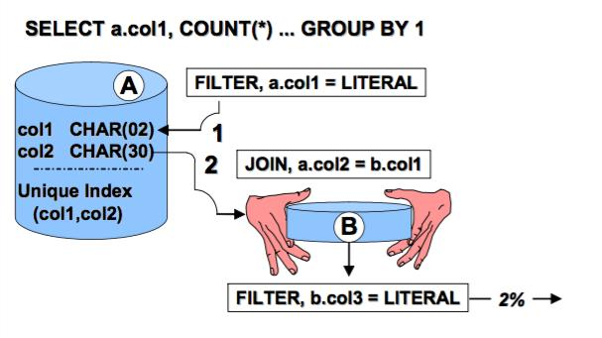
Query 4: Join and predicate

Slide 19
Query 4: Optimal plan

Slide 20
FJS versus ESR: MongoDB
SELECT *
FROM collection
WHERE
col1 = ‘x’ and col2 > ‘y’
ORDER BY col3;
Filter -> Join -> Sort (FJS)
Equality -> Sort -> Range (ESR)
Notes:
Pipelined sort

Slide 21
I inherited a MongoDB database server with 60 collections and 100 or so indexes.
The business users are complaining about slow report completion times.
What can I do to improve performance ?
Problem statement:

Slide 22
Skills/tools we need:
Which server
Which logfile
Server profiling Level
Which queries
Cloud/Ops Manager !!
mtools
Text processing
Drop the query plan
Analyze the query plan
Which indexes get used
Other

Slide 23
Sample data set: zips.json
> db.zips.findOne()
{
"_id" : ObjectId("570 .. 1c1f2"),
"city" : "ACMAR",
"zip" : "35004",
"loc" : {
"y" : 33.584132,
"x" : 86.51557
},
"pop" : 6055,
"state" : "AL"
}
> db.zips.count()
29470
>db.zips.find( { "state" : "WI", "pop" : { "$lt" : 50 } } ).sort( { "city" : 1 } )

Slide 24
Query 5: Dumping the query plan
"winningPlan" : {
"stage" : "SORT", "sortPattern" : { "city" : 1 },
"inputStage" : {
"stage" : "COLLSCAN",
"filter" : {
"$and" : [ "state" : { "$eq" : "WI" "pop" : { "$lt" : 50
"rejectedPlans" : [ ]
"executionStats" : {
"nReturned" : 4,
"executionTimeMillis" : 16,
"totalKeysExamined" : 0,
"totalDocsExamined" : 29470,
db.zips.find( { "state" : "WI",
"pop" : { "$lt" : 50 } } ).sort(
{ "city" : 1 } ).explain("executionStats")

Slide 25
Query 5: get indexes
> db.zips.getIndexes()
[ {
"v" : 1, "key" : { "_id" : 1 },
"name" : "_id_",
"ns" : "test_db.zips"
} ]
db.zips.createIndex( { "state" : 1 , "pop" : 1 } )

Slide 26
Query 5: attempt 2
winningPlan" : {
"stage" : "SORT", "sortPattern" : { "city" : 1 },
"inputStage" : {
"stage" : "FETCH",
"inputStage" : {
"stage" : "IXSCAN",
"keyPattern" : { "state" : 1, "pop" : 1 },
"indexBounds" : {
"state" : [ "[\"WI\", \"WI\"]" ],
"pop" : [ "[-inf.0, 50.0)" ]
"executionStats" : {
"nReturned" : 4,
"executionTimeMillis" : 1,
"totalKeysExamined" : 4,
"totalDocsExamined" : 4,

Slide 27
Query 5: attempt 3
db.zips.createIndex( { "state" : 1 , "city" : 1 , "pop" : 1 } )
"winningPlan" : {
"stage" : "SORT", "sortPattern" : { "city" : 1
"inputStage" : {
"stage" : "FETCH",
"inputStage" : {
"stage" : "IXSCAN",
"keyPattern" : { "state" : 1, "pop" : 1
"rejectedPlans" : [
"stage" : "FETCH",
"inputStage" : {
"stage" : "IXSCAN",
"keyPattern" : { "state" : 1, "city" : 1, "pop" : 1 },
"indexBounds" : {
"state" : [ "[\"WI\", \"WI\"]" ],
"city" : [ "[MinKey, MaxKey]" ],
"pop" : [ "[-inf.0, 50.0)" ]

Slide 28

Query 6: (pseudo order by clause)
db.zips.find( { "state" : "CO" }
).sort( { "pop" : 1 } )
SELECT * FROM t1
WHERE col1 = ‘x’
ORDER BY col2;
SELECT * FROM t1
WHERE col1 = ‘x’
ORDER BY col1, col2;
SELECT * FROM t1
WHERE col1 = ‘x’
ORDER BY ‘x’, col2;
Notes:
This was the first index we made in example 1

Slide 29
Query 6: query plan
"winningPlan" : {
"stage" : "FETCH",
"inputStage" : {
"stage" : "IXSCAN",
"keyPattern" : { "state" : 1, "pop" : 1 },
"indexBounds" : {
"state" : [ "[\"CO\", \"CO\"]" ],
"pop" : [ "[MinKey, MaxKey]" ]
"rejectedPlans" : [
"stage" : "SORT",
"sortPattern" : { "pop" : 1 },
"inputStage" : {
"stage" : "FETCH",
"inputStage" : {
"stage" : "IXSCAN",
"keyPattern" : { "state" : 1, "city" : 1, "pop" : 1 },
"indexBounds" : {
"state" : [ "[\"CO\", \"CO\"]" ],
"city" : [ "[MinKey, MaxKey]" ],
"pop" : [ "[MinKey, MaxKey]" ]
"executionStats" : {
"nReturned" : 416,
"executionTimeMillis" : 1,
"totalKeysExamined" : 416,
"totalDocsExamined" : 416,

Slide 30
Review the indexes we have so far
> db.zips.getIndexes()
_id
db.zips.createIndex( { "state" : 1 , "pop" : 1 } )
db.zips.createIndex( { "state" : 1 , "city" : 1 , "pop" : 1 } )

Slide 31
Query 7: OR topped query
db.zips.find( { "$or" : [ { "state" : "UT" }, { "pop" : 2 } ] } )
"winningPlan" : {
"inputStage" : {
"stage" : "COLLSCAN",
"filter" : {
"$or" : [
"pop" : { "$eq" : 2 }
"state" : { "$eq" : "UT" }
"rejectedPlans" : [ ]
"executionStats" : {
"nReturned" : 215,
"executionTimeMillis" : 22,
"totalKeysExamined" : 0,
"totalDocsExamined" : 29470,
SELECT * FROM t1
WHERE
order_date = TODAY
OR
ship_weight < 10;

Slide 32
Query 7: solution
db.zips.createIndex( { "pop" : 1 } )
"winningPlan" : {
"inputStage" : {
"stage" : "FETCH",
"inputStage" : {
"stage" : "OR",
"inputStages" : [
"stage" : "IXSCAN",
"keyPattern" : { "state" : 1, "pop" : 1 },
"indexBounds" : {
"state" : [ "[\"UT\", \"UT\"]" ],
"pop" : [ "[MinKey, MaxKey]" ]
"stage" : "IXSCAN",
"keyPattern" : { "pop" : 1 },
"indexBounds" : {
"pop" : [ "[2.0, 2.0]" ]
"rejectedPlans" : [ ]
"executionStats" : {
"nReturned" : 215,
"executionTimeMillis" : 2,
"totalKeysExamined" : 215,
"totalDocsExamined" : 215,

Slide 33
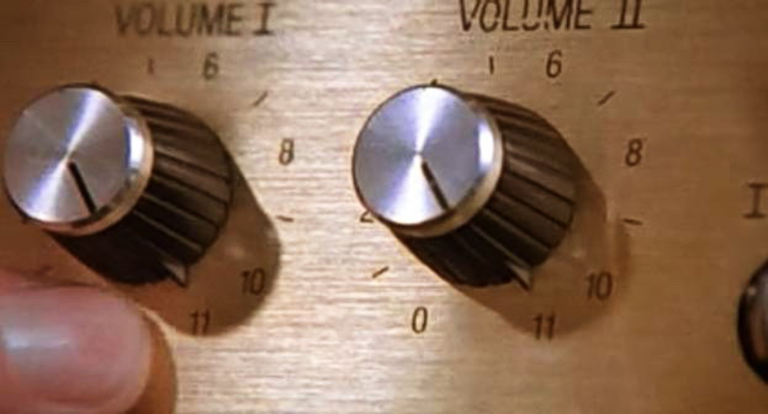
Topics not previously covered
How to tell which indexes are being used
How to tell if an index is unique
Smoke tests
Covered queries
MongoDB index types
When do winning query plans get evacuated
Index intersection
Building indexes (online/offline)
Sharding and queries, query plans
Capped collections, tailable cursors
Optimizer hints
Memory limits
Query rewrite (aggregation pipeline optimization)
Which server
Which logfile
(Server profiling Level)
Which queries
mtools
Text processing

Slide 34
Resources:
The parent to this preso,
https://github.com/farrell0/MongoDB-Developers-Notebook
An excellent query primer (110 pages)
http://www.redbooks.ibm.com/abstracts/sg247138.html?Open
(Chapters 10 and 11.)
University.MongoDB.com
https://www.mongodb.com/consulting-test#performance_evaluation
zips.json
http://media.mongodb.org/zips.json
Call Dave Lutz, at home, .. .. On Sunday (early)
(512)555/1212

Slide 35
Backup Slides

Slide 36
How to tell which indexes are being used
db.zips.aggregate( [ { "$indexStats" : {} } ] ).pretty()
{ "name" : "pop_1",
"key" : { "pop" : 1 },
"host" : "rhhost00.grid:27017",
"accesses" : {
"ops" : NumberLong(15),
"since" : ISODate("2016-04-19T07:13:44.546Z") } }
{ "name" : "state_1_city_1_pop_1",
"key" : { "state" : 1, "city" : 1, "pop" : 1 },
"host" : "rhhost00.grid:27017",
"accesses" : {
"ops" : NumberLong(0),
"since" : ISODate("2016-04-19T06:49:11.765Z") } }

Slide 37
How to tell if an index is unique
db.t1.createIndex( { "k1" : 1 },
{ "unique" : true })
{
"createdCollectionAutomatically" : true,
"numIndexesBefore" : 1,
"numIndexesAfter" : 2,
"ok" : 1
}
> db.t1.getIndexes()
[ { "v" : 1,
"key" : { "_id" : 1 },
"name" : "_id_",
"ns" : "test_db.t1“ },
{ "v" : 1,
"unique" : true,
"key" : { "k1" : 1 },
"name" : "k1_1",
"ns" : "test_db.t1“ }
]

Slide 38
Smoke tests
Every night, gather a set of statistics about your hard disk fullness, and about the performance of a set of queries that are strategic to the application.
For queries we wish to record-
The number of documents returned
The winning query plan
Elapsed time, disk and memory consumed
Other

Slide 39
Covered queries
> db.zips.find( { "pop" : { "$lt" : 200 } },
{ "_id" : 0, "pop" : 1 } ).sort(
{ "pop" : -1 } ).explain()
"winningPlan" : {
"stage" : "PROJECTION",
"transformBy" : {
"_id" : 0,
"pop" : 1 },
"inputStage" : {
"stage" : "IXSCAN",
"keyPattern" : { "pop" : 1 },
"indexBounds" : {
"pop" : [ "(200.0, -inf.0]" ]
"rejectedPlans" : [ ]
}

Slide 40
When does the winning plan get evacuated
In short, the cached query plan is re-evaluated if:
The collection receives 1000 or more writes
An index is added or dropped
A reindex operation is performed
mongod is restarted
You run a query with explain

Slide 41
Index intersection
db.zips.find( { "$or" : [ { "state" : "UT" }, { "pop" : 2 } ] } )
db.zips.find( { "city" : "EAST TROY", "zip" : 53120 } )

Slide 42
Building indexes
db.zips.createIndex( { “zip” : 1 }, { “background” : true } )

Slide 43
Capped collections
from pymongo import Connection
import time
db = Connection().my_db
coll = db.my_collection
cursor = coll.find(tailable=True)
while cursor.alive:
try:
doc = cursor.next()
print doc
except StopIteration:
time.sleep(1)
db.createCollection("my_collection",
{ capped : true, size : 5242880,
max : 5000 } )

Slide 44
Memory limits: 32 MB, 100 MB
db.zips.aggregate([
{ "$group" :
{ "_id" : "$state",
//
"totalPop" : { "$sum" : "$pop" },
"cityCount" : { "$sum" : 1 }
}
} ,
{ "$sort" : { "_id" : 1 } }
],
{ "allowDiskUse" : true }
)
"executionStages" : {
"stage" : "SORT",
"nReturned" : 1,
"executionTimeMillisEstimate" : 60,
…
"sortPattern" : { "City" : 1 },
"memUsage" : 120,
"memLimit" : 33554432,

Slide 45
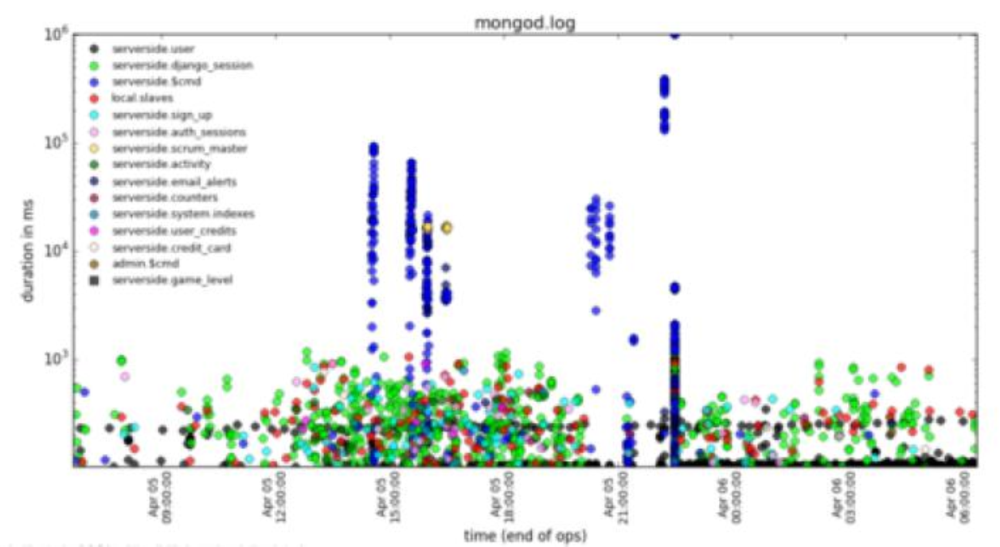
mtools: mplotquery

Slide 46
But first:
Y/N I have more than 24 months experience with SQL
Y/N I have more than 6 months
experience with MongoDB
Y/N I have dropped a MongoDB
explain plan, understood it,
made changes, and was happy
Y/N Puppies scare me

Slide 47

Two more examples: Queries 8 and 9
find()
aggregate()
optimizer hints
$lookup()

Slide 48
Query 8: automatic query rewrite
> db.zips.aggregate(
... [
... { "$sort" :
... { "state" : 1 }
... },
... {
... "$match" :
... { "state" : { "$gt" : "M" } }
... }
... ],
... { "explain" : true } )

Slide 49
Query 8: Explain plan
"stages" : [
"$cursor" : {
"sort" : { "state" : 1 },
"winningPlan" : {
"stage" : "FETCH",
"inputStage" : {
"stage" : "IXSCAN",
"indexName" : "state_1_city_1",
"indexBounds" : {
"state" : [ "(\"M\", {})" ],
"city" : [ "[MinKey, MaxKey]" ]
"rejectedPlans" : [ ]

Slide 50
Query 9: Optimizer hints
> db.zips.find( { "city" : "EAST TROY" }).hint(
{ "zip" : 1} ).explain("executionStats")
"winningPlan" : {
"stage" : "FETCH",
"filter" : { "city" : { "$eq" : "EAST TROY" } },
"inputStage" : {
"stage" : "IXSCAN", "keyPattern" : { "zip" : 1 },
"indexBounds" : { "zip" : [ "[MinKey, MaxKey]" ] }
"rejectedPlans" : [ ]
"executionStats" : {
"nReturned" : 1,
"executionTimeMillis" : 28,
"totalKeysExamined" : 29470,
"totalDocsExamined" : 29470,

